Slide 1
Machine Learning applied: Prediction of Micro-Credit Defaulter based on data from mobile financial services (MFS)
Submitted by: Anshul Shrivastava

Slide 2
Review of Literature
This paper provides a systematic assessment of customer behavior and the trend of loan taken Vs loan paid back to the Microfinance Institution (MFI) in Indonesia bases on the above given factors. From our analysis and research done one can understand that depending on what factors customers are ending up on being a defaulter, using this study a Microfinance Institution (MFI) can predict that a customer can be a defaulter or not basis on which Microfinance Institution (MFI) can confer short-term loans.
Further our study helps the Micro finance institution to understand, analysis and predict the futuristic behavior of a customer that could help them in further speculation and improvement in selection of customers.

Slide 3
About Microfinance Institution
A Microfinance Institution (MFI) is an organization that offers financial services to low-income populations. MFS becomes very useful when targeting especially the unbanked poor families living in remote areas with not much sources of income. The Microfinance services (MFS) provided by MFI are Group Loans, Agricultural Loans, Individual Business Loans and so on.

Slide 4
Prediction of Micro-Credit Defaulter
Problem statement
EDA steps and visualizations
Steps and assumptions
Model dashboard
Finalized model
Conclusion

Slide 5
Problem statement
Build a model using the best machine learning algorithm which can be used to predict in terms of a probability for each loan transaction, whether the customer will be paying back the loaned amount within 5 days of insurance of loan. In this case, Label ‘1’ indicates that the loan has been paid i.e., Non- defaulter, while, Label ‘0’ indicates that the loan has not been paid i.e., defaulter

Slide 6
EDA steps and visualizations
Deleting the duplicate records.
Deleting the irreverent data and columns.
Splitting date columns into machine Learning understandable format.
Removing Skewness and outliers.

Slide 7
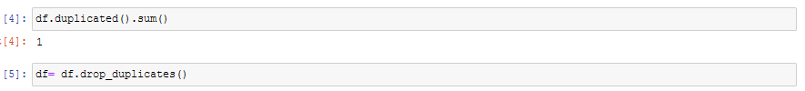
Deleting the duplicate records.
The first step of EDS started with cleansing the data with removing the duplicate records since duplicate records reduces the performance of the model.

Slide 8
Deleting the irreverent data and columns
Identified that ‘msisdn’ and ‘pcircle’ have unique values and same value respectively for all the columns, so I have dropped these two columns to make the data more predictable

Slide 9
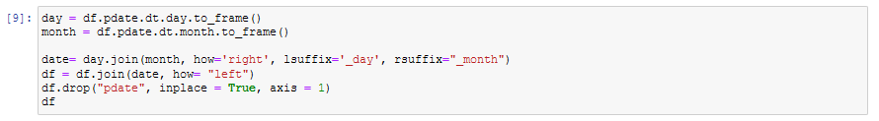
Splitting Date columns into machine Learning understandable format.
From the given data I have observed that data is taken from year 2016 and mostly of 06th, 07th, 08th months and I have split the ‘pdate’ columns into ‘pdate_day’ and ‘pdate_month’ to reduce the complexity and dropped ‘pdate’.

Slide 10
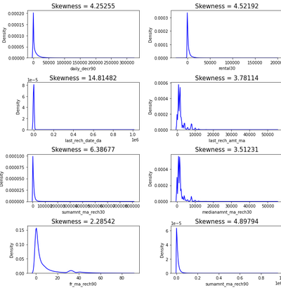
Removing Skewness and outliers.
The data is observed to have extreme positive skewness.
The sample of data is displayed we will correct the skewness by Power transformation method.

Slide 11
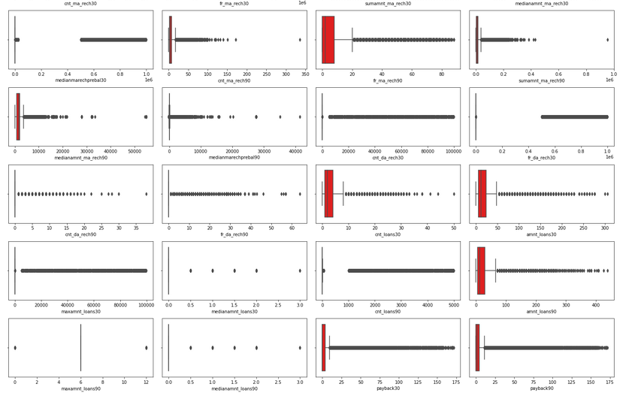
Outliers
Data seems to have too many outliers removal of outliers will deform the data and we will loose more data. So I have decided to work with outliers

Slide 12
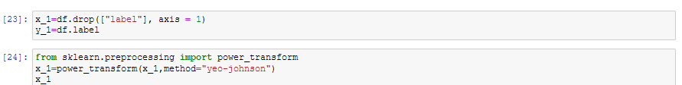
Removal of Skewness.
The Pre-Processing of the data is completed with the skewness removal, data is completely ready for split and train with the model, before which I have tried in understanding the logic of output based on the input and also the from the data and insights that is derived from the data and also with the correlation of all the data, I have tried in getting pre-assumed insight ideas on which the output is defined. We are seeing about these pre-assumed ideas with the tools used in deriving these ideas are as follows.

Slide 13
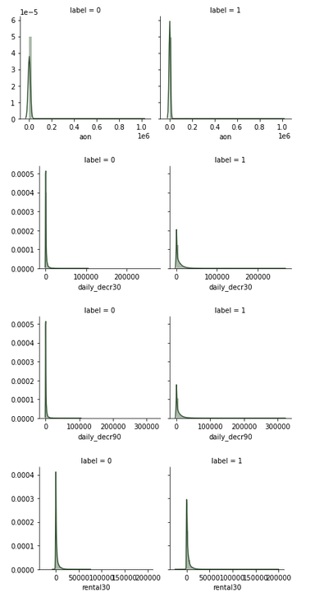
Visualizations Data insights
We can observe that daily_dec30, daily_dec90, rental30 have more contribution on label - 0

Slide 14
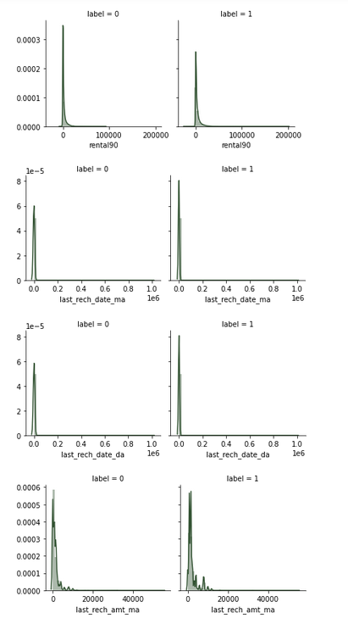
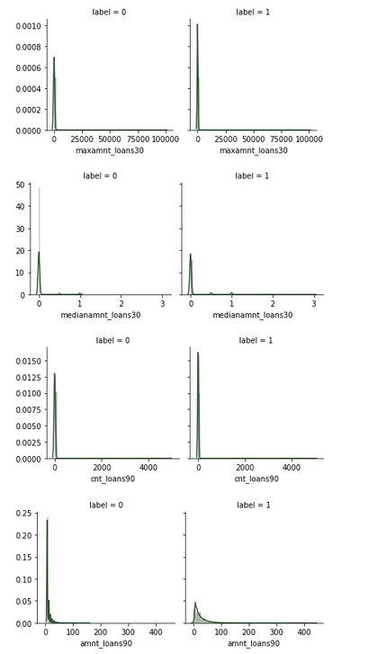
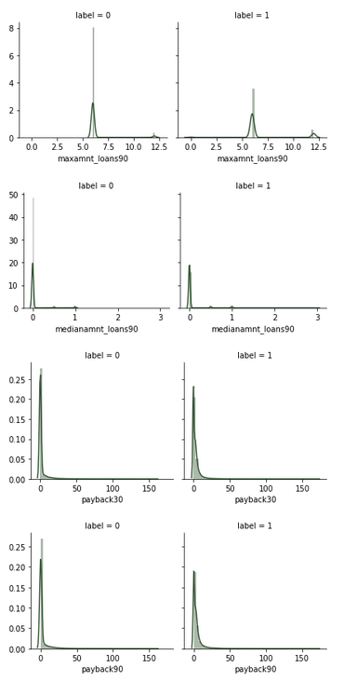
Visualizations Data insights
1. aon, last_rech_date_ma, last_rech_date_da, fa_ma_rech30, medianmarechprebal30, medianamnt_ma_rech90, cnt_da_rech30, fr_da_rech30, maxamnt_loan30, cnt_loans90 have more contributions in 1.

Slide 15
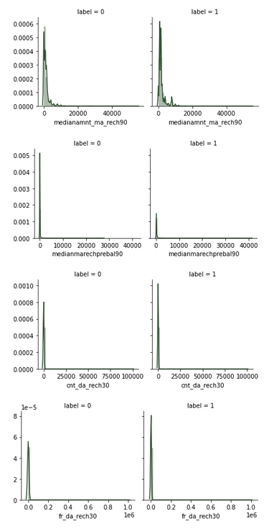
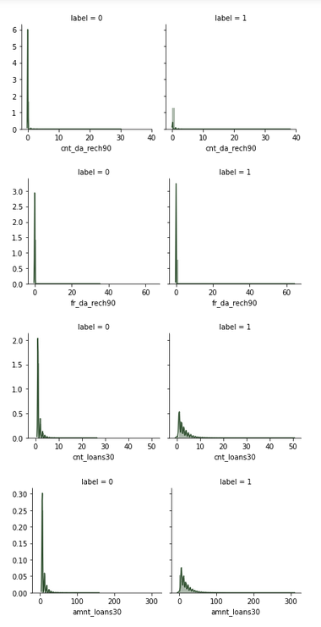
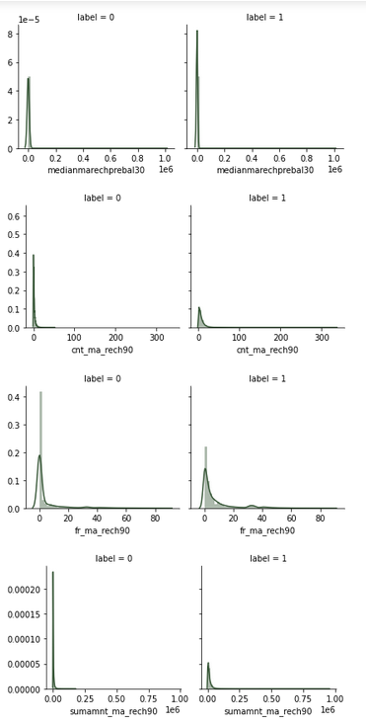
Visualizations Data insights
4. payback90, payback30, medianamnt_loans90, fr_da_reach90, medianamnt_ma_reach90, medianamnt_ma_reach30, last_rech_amt_ma almost have equal contributions in 0 and 1.

Slide 16
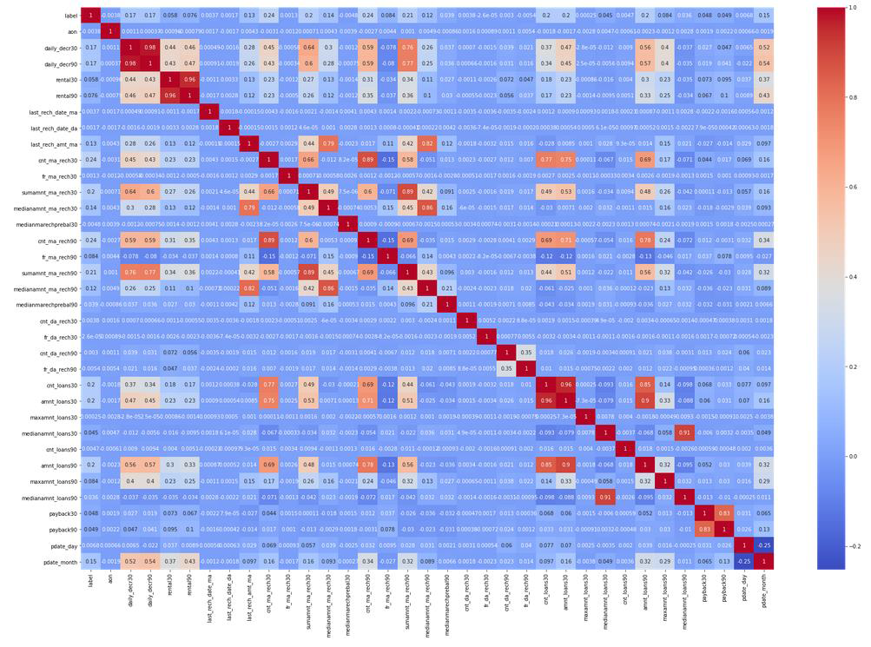
Correlation Visualizations.
Key Insights from Correlation:
➢ From above we can observe that "cnt_ma_rech30", "cnt_ma_rech90", "sumamnt_ma_rech90", "sumamnt_ma_rech30" have more correlation with the Target variable "label". Let’s visualize the feature variable correlation with target variable separately.
➢ 'daily_decr30', 'daily_decr90', 'rental30', 'rental90', 'last_rech_amt_ma', 'cnt_ma_rech30', 'sumamnt_ma_rech90', 'medianamnt_ma_rech90', 'cnt_loans30', 'amnt_loans30', 'amnt_loans90', 'maxamnt_loans90’, have more correlation with each other, which is these variables are dependent on each other.

Slide 17
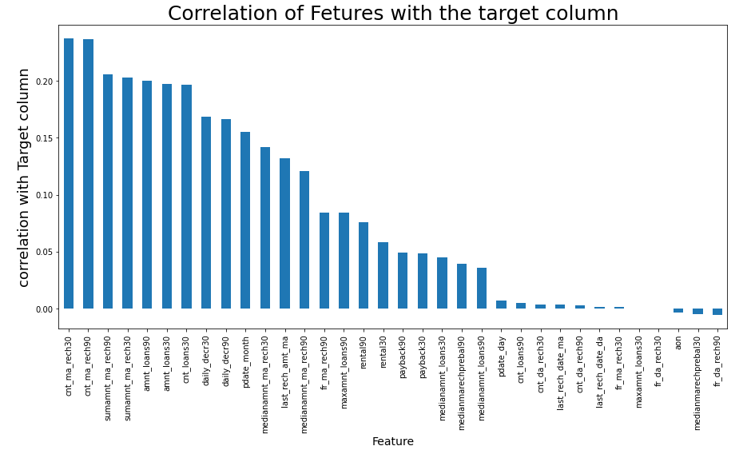
Correlation only with Target Variable
Key Observations:
From above we can observe that "cnt_ma_rech30", "cnt_ma_rech90", "sumamnt_ma_rech90", "sumamnt_ma_rech30" have more correlation with the Target variable "label".
We have more positive correlated variable than the negative correlated variable.

Slide 18
Steps and Assumptions.
With all the insights taken we have plotted few pre-assumptions which are as follows.
As like said above Label ‘1’ indicates that the loan has been paid i.e., Non- defaulter, while, Label ‘0’ indicates that the loan has not been paid i.e., defaulter.
daily_dec30, daily_dec90, rental30, rental90, cnt_da_rech30, sumamnt_ma_rech30, cnt_ma_rech90, sumamnt_ma_rech90, medianmarechprebal90, cnt_da_rech90, cnt_loans30, amnt_loans30, amnt_loans90, the above columns have more contributions in 0 that is defaulter, which means that customer have more contributions on above factors end up as defaulter.
aon, last_rech_date_ma, last_rech_date_da, fa_ma_rech30, medianmarechprebal30, medianamnt_ma_rech90, cnt_da_rech30, fr_da_rech30, maxamnt_loan30, cnt_loans90 have more contributions in 1. which means that customer have more contributions on above factors end up as not a defaulter.
payback90, payback30, medianamnt_loans90, fr_da_reach90, medianamnt_ma_reach90, medianamnt_ma_reach30, last_rech_amt_ma almost have equal contributions in 0 and 1.

Slide 19
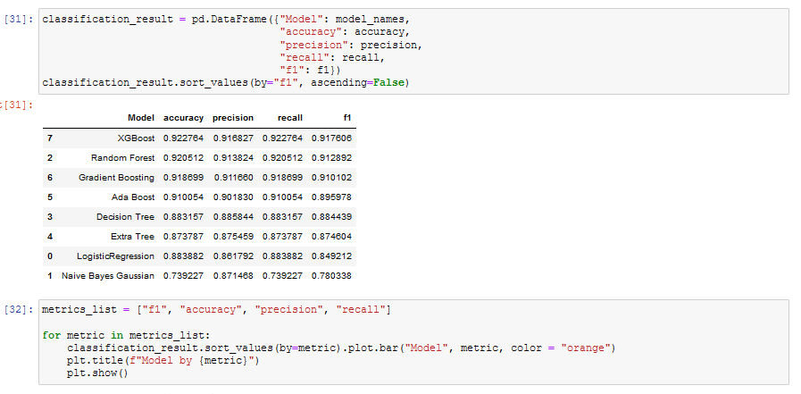
Model Dashboard
We have trained our model based on eight different Classification algorithm and have shortlisted the best algorithm with metrics as follows.

Slide 20
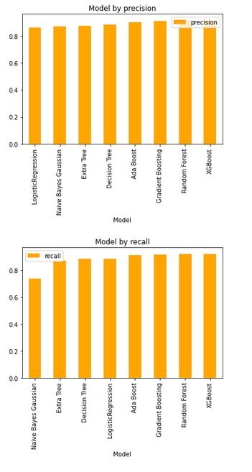
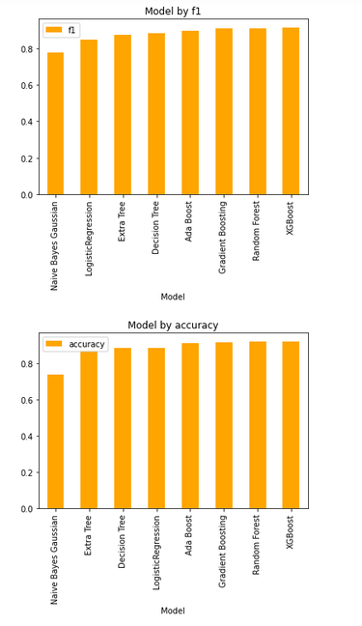
Model Dashboard
From above we see that Xg Boost model have top the chart at F1-Score of 91.7606% and accuracy of 92.2764%. I have further hyper tuned the same Xg Boost model for better performance.

Slide 21
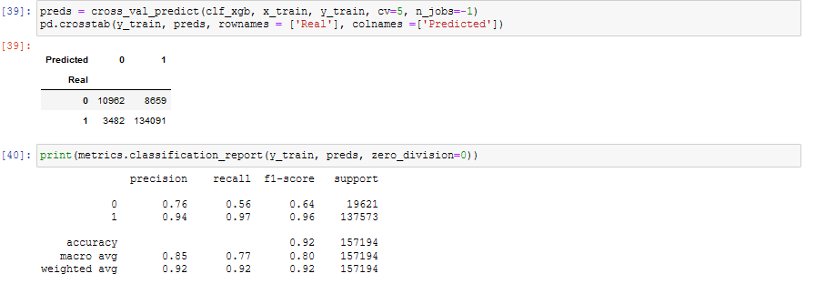
Finalized model Classification matrix of XG boost
From above metrics we can understand how Xgboost model have performed and also overfitting in the model is very minimal since the model have accuracy of 92%.

Slide 22
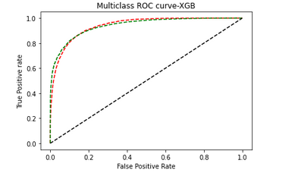
Finalized model ROC-AUC curve of XG boost
From above metrics we can understand how Xgboost model have performed and also overfitting in the model is very minimal since the model have accuracy of 92%. We also saw the ROC-AUC curve which

Slide 23
Conclusion
Key Findings and Conclusions of the Study
From our above analysis we understand that which factors are responsible and using which a Microfinance Institution (MFI) can predict that a customer can be a defaulter or not a defaulter basis on which Microfinance Institution (MFI) can give a short-term loan and predictions that could help them in further investment and improvement in selection of customers.
Limitations of this work and Scope for Future Work
Limitations of the study arise from the use of a single dataset obtained from one company. However, the large number of loans and customers considered and generic applicability of credit scoring for mobile credit suggests that the variables and models investigated are relevant for other business applications. Further work may include the use of demographic information which could be obtained from mobile network operators and consideration of additional pay-as-you-go mobile products.

Slide 24
THANK YOU

